Slide 1
JavaScript HTML DOM

Slide 2
The HTML DOM (Document Object Model)
When a web page is loaded, the browser creates a Document Object Model of the page.
The HTML DOM model is constructed as a tree of Objects:

Slide 3
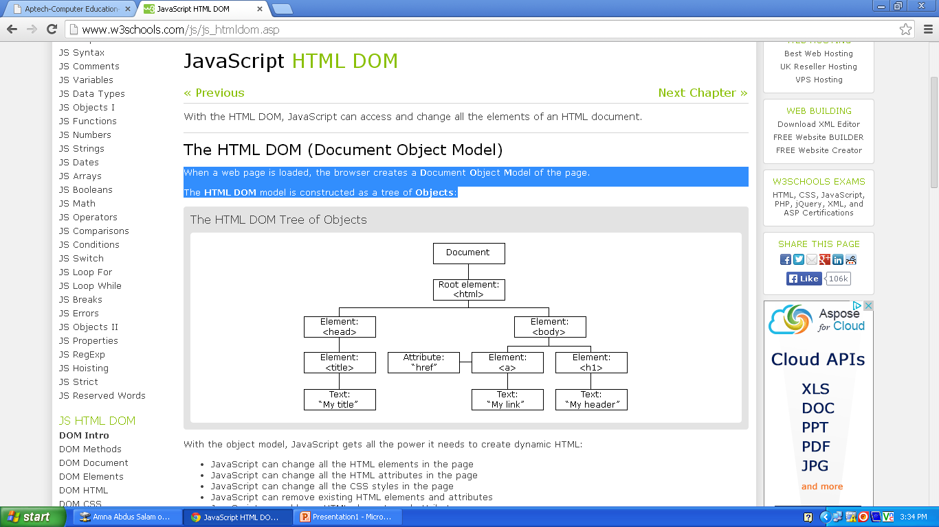
DOM FLOW CHART

Slide 4
With the object model, JavaScript gets all the power it needs to create dynamic HTML:
JavaScript can change all the HTML elements in the page
JavaScript can change all the HTML attributes in the page
JavaScript can change all the CSS styles in the page
JavaScript can remove existing HTML elements and attributes
JavaScript can add new HTML elements and attributes
JavaScript can react to all existing HTML events in the page

Slide 5
What is the HTML DOM?
The HTML DOM is a standard object model and programming interface for HTML. It defines:
The HTML elements as objects
The properties of all HTML elements
The methods to access all HTML elements
The events for all HTML elements

Slide 6
HTML DOM Methods
HTML DOM methods are actions you can perform (on HTML Elements)
HTML DOM properties are values (of HTML Elements) that you can set or change

Slide 7
The getElementById Method
The most common way to access an HTML element is to use the id of the element.

Slide 8
The innerHTML Property
The easiest way to get the content of an element is by using the innerHTML property.
The innerHTML property is useful for getting or replacing the content of HTML elements.

Slide 9
The HTML DOM Document
In the HTML DOM object model, the document object represents your web page.
The document object is the owner of all other objects in your web page.
If you want to access objects in an HTML page, you always start with accessing the document object.

Slide 10
Finding HTML Elements
Method | Description
document.getElementById() | Finding an element by element id
document.getElementsByTagName() | Finding elements by tag name
document.getElementsByClassName() | Finding elements by class name
document.forms[] | Finding elements by HTML element objects

Slide 11
Changing HTML Elements
Method | Description
element.innerHTML= | Changing the inner HTML of an element
element.getAttribute= | Accessing the attribute of an HTML element
element.setAttribute(attribute,value) | Changing the attribute of an HTML element
element.style.property= | Changing the style of an HTML element

Slide 12
Finding HTML Elements
Often, with JavaScript, you want to manipulate HTML elements.
To do so, you have to find the elements first. There are a couple of ways to do this:
Finding HTML elements by id
Finding HTML elements by tag name
Finding HTML elements by class name
Finding HTML elements by HTML object collections

Slide 13
Finding HTML Elements by Id
The easiest way to find HTML elements in the DOM, is by using the element id.
If the element is found, the method will return the element as an object (in x).
If the element is not found, x will contain null.

Slide 14

This example finds the element with id="intro":
<html>
<body>
<p id=“para1">Hello World!</p>
<script>
x=document.getElementById(“para1");
document.write("<p>The text from the para1 paragraph: " + x.innerHTML + "</p>");
</script>
</body>
</html>

Slide 15
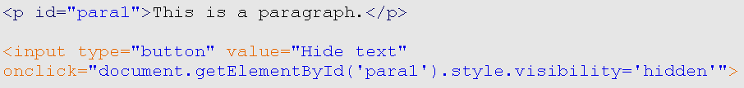


After clicking

Slide 16
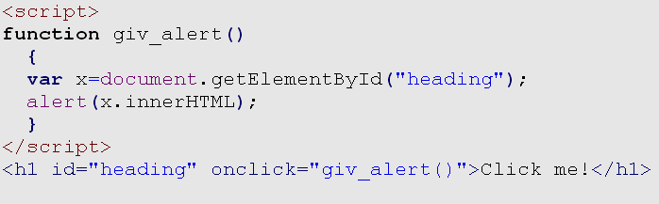


After clicking on the text an alert box appears.

Slide 17
Finding HTML Elements by Class Name
If you want to find all HTML elements with the same class name. Use this method:
document.getElementsByClassName(“abc");
The example above returns a list of all elements with class=“abc".
[Finding elements by class name does not work in Internet Explorer 5,6,7, and 8]

Slide 18
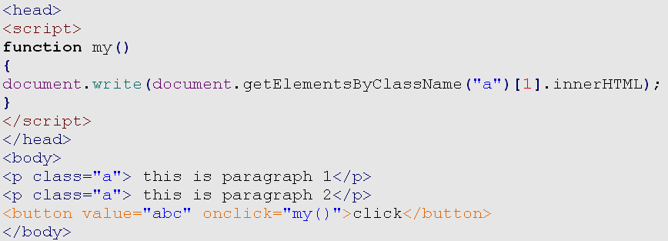
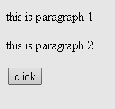

After clicking

Slide 19
document.getElementsByTagName()
Finding elements by tag name
View It

Slide 20
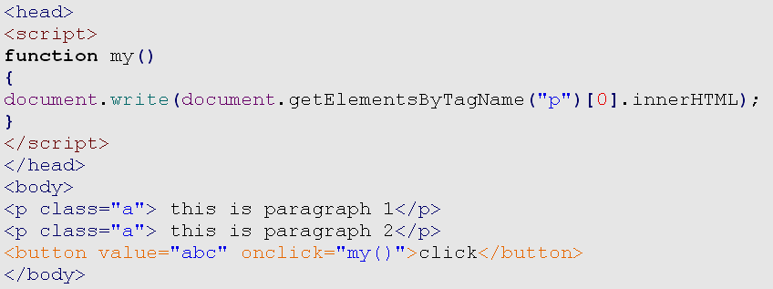
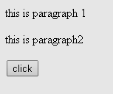

After clicking

